Slide 1

Time Series Forecast Model of Bitcoin Prices Predictive Analytics for Financial Decision-Making
Course: Data Mining for Managers (DSCI 725)
Instructor: Professor Thomas Tiahrt, PhD
Project Lead: Swetha Rani Keshava Ravi LNU
Submission Date: April 2026

Slide 2
Introduction
Bitcoin = highly volatile asset
Difficult to predict
Time series models help identify patterns

Slide 3
Business Problem
Investors struggle with timing decisions
High risk due to volatility
Need better short-term forecasts

Slide 4
Data Source
Source: Kaggle dataset
Period: 2014–2023
Daily observations

Slide 5
Variables
Column | Description | Type
Date | Daily observation date | Date
Open | Opening price of Bitcoin | Numeric
High | Highest price of the day | Numeric
Low | Lowest price of the day | Numeric
Close | Closing price of Bitcoin (target variable) | Numeric
Volume | Trading volume | Numeric
Open, High, Low, Close
Volume
Target: Close price

Slide 6
Data Preparation
Cleaned missing values
Sorted by date
Log transformation
Differencing

Slide 7
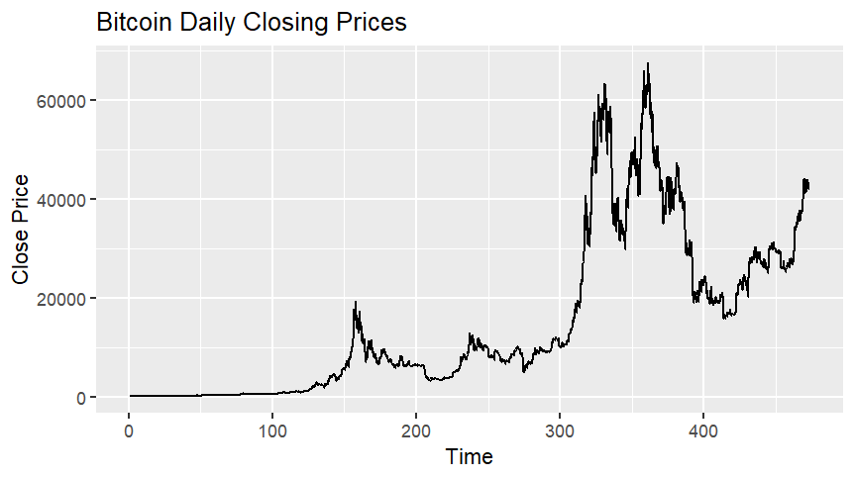
Time Series Plot
Insert price chart
Bullet:
Upward trend
High volatility

Slide 8
Stationarity
ADF test result
Non-stationary → stationary after differencing

Slide 9
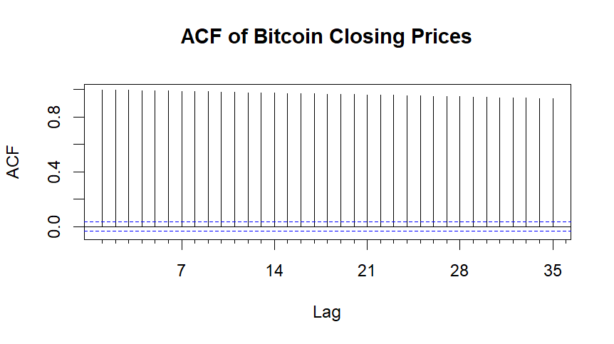
ACF Plot
Strong autocorrelation
Slow decay

Slide 10
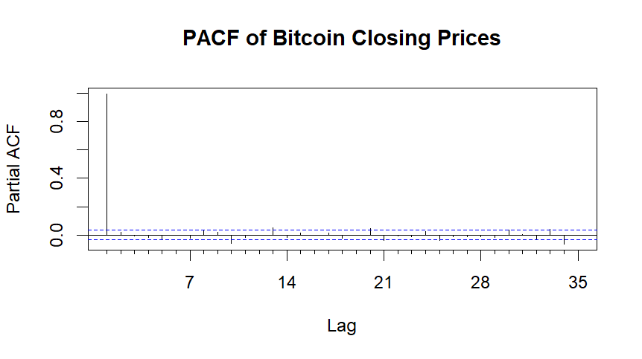
PACF Plot
Spike at lag 1

Slide 11
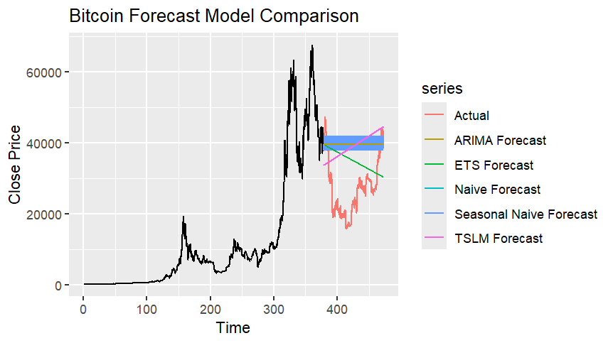
Models Used
Naïve
Seasonal Naïve
ETS
ARIMA
TSLM

Slide 12
Overfitting
Train-test split (80/20)
Tested on unseen data
Model comparison

Slide 13
Model Tuning
auto.arima()
Parameters: p, d, q
AIC optimization

Slide 14
Model Performance
Lowest RMSE, MAE, MAPE
ARIMA → Best interpretability / structural analysis
ETS → Best forecasting accuracy

Slide 15
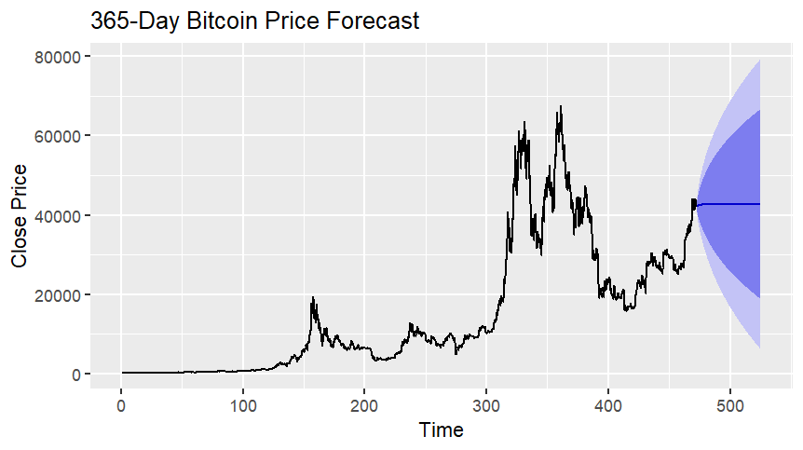
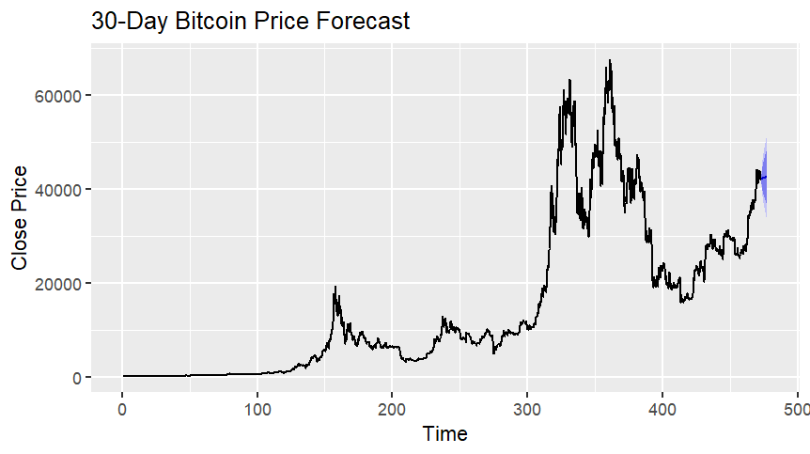
Forecast Results
30-day forecast
365-day forecast
Increasing uncertainty

Slide 16
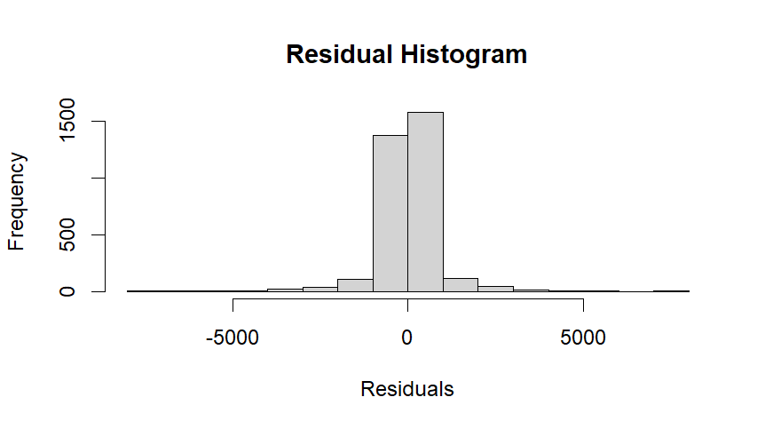
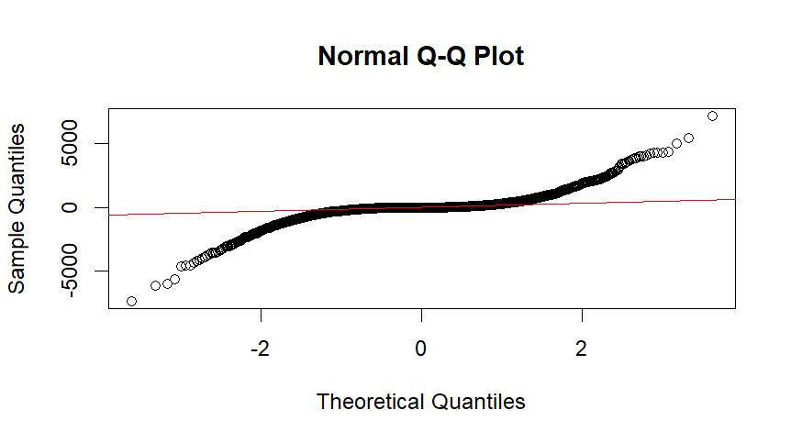
Residual Diagnostics
Non-normal distribution
Outliers
Volatility

Slide 17
Key Insights
Strong dependence on past values
ARIMA best for short-term
High volatility limits long-term accuracy

Slide 18
Conclusion
Models useful for decisions
ETS achieved the best forecasting accuracy, while ARIMA provided strong interpretability for time-dependent structure.
Use cautiously

